Slide 1
Lab 2 Arithmetic Recombination + Uniform Mutation
Guotong Wu

Slide 2
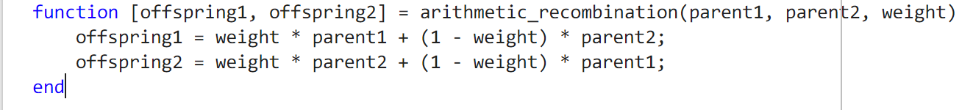
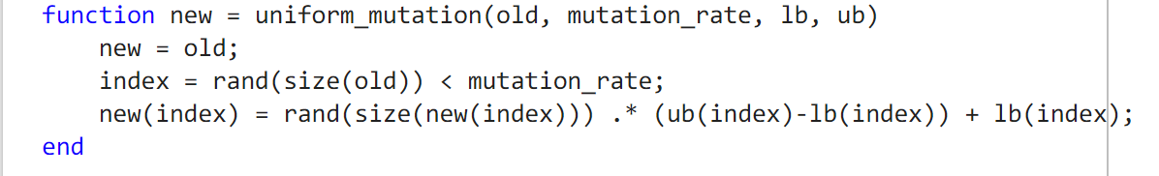
Arithmetic Recombination
Uniform Mutation

Slide 3
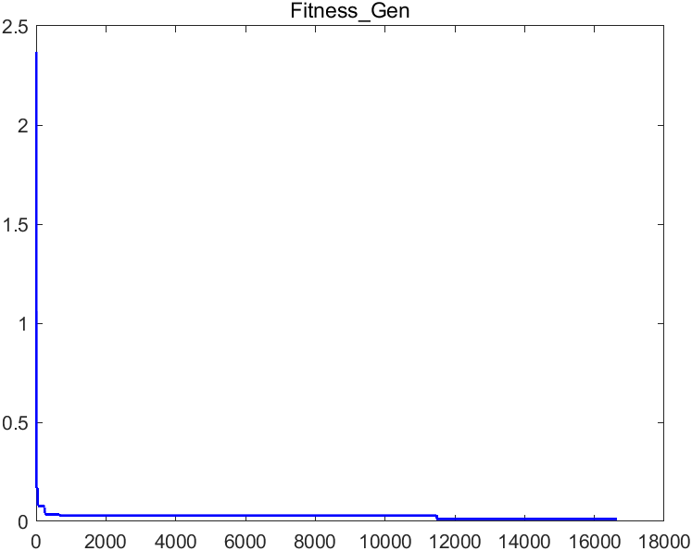
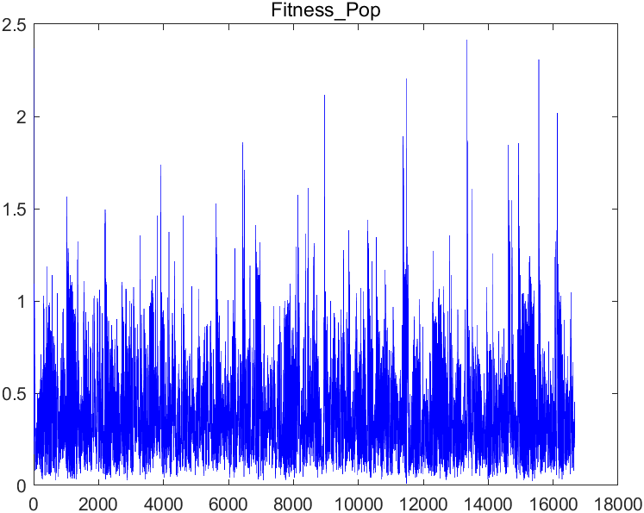
Result: 1 runs

Slide 4
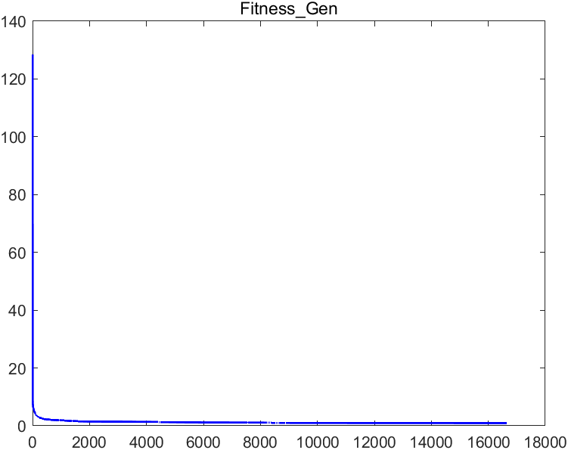
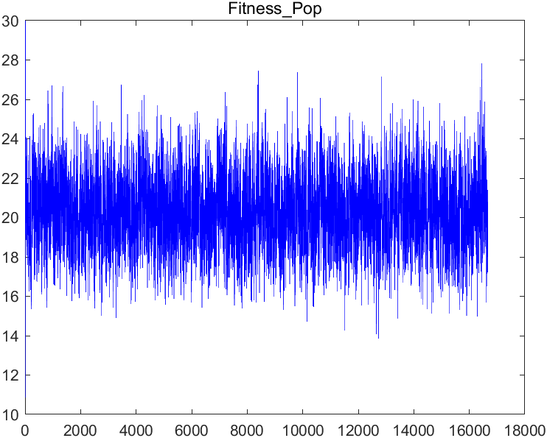
Result: 50 runs
Average makes it very disappointing

